Slide 1
Università degli Studi di Messina Dipartimento di Scienze Matematiche e Informatiche Scienze Fisiche e Scienze della Terra Corso di Laurea Triennale in Informatica
Big Data Acquisition for
Enhanced Healthcare Insights
TESI DI LAUREA DI:
NOME STUDENTE:
Yoshan Abiranjana Mendis
Gunaratna(528176)
RELATORE:
Prof. Ing. Armando Ruggeri
_____________________________________________________________________________________
Anno Accademico 2023/2024

Slide 2
Content
Introduction
Objectives
Data Praperation
Data Argumentation
Convolutional Neural Network
ResNet-50
Models Accuracy
Region of Interest
Comparison of Models Training Time
Conclusion And Future Development

Slide 3
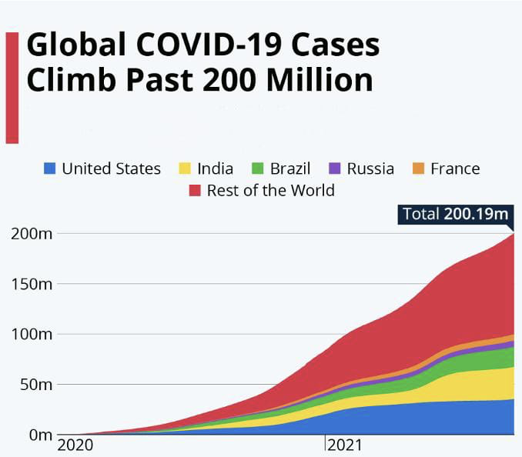
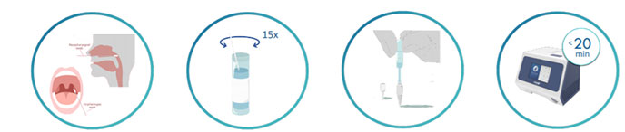
Introduction
The COVID-19 coronavirus has caused big damage to the global health infrastructure during the period of 2021 to 2022.
The traditional diagnostic techniques, though useful, are very time-consuming.

Slide 4
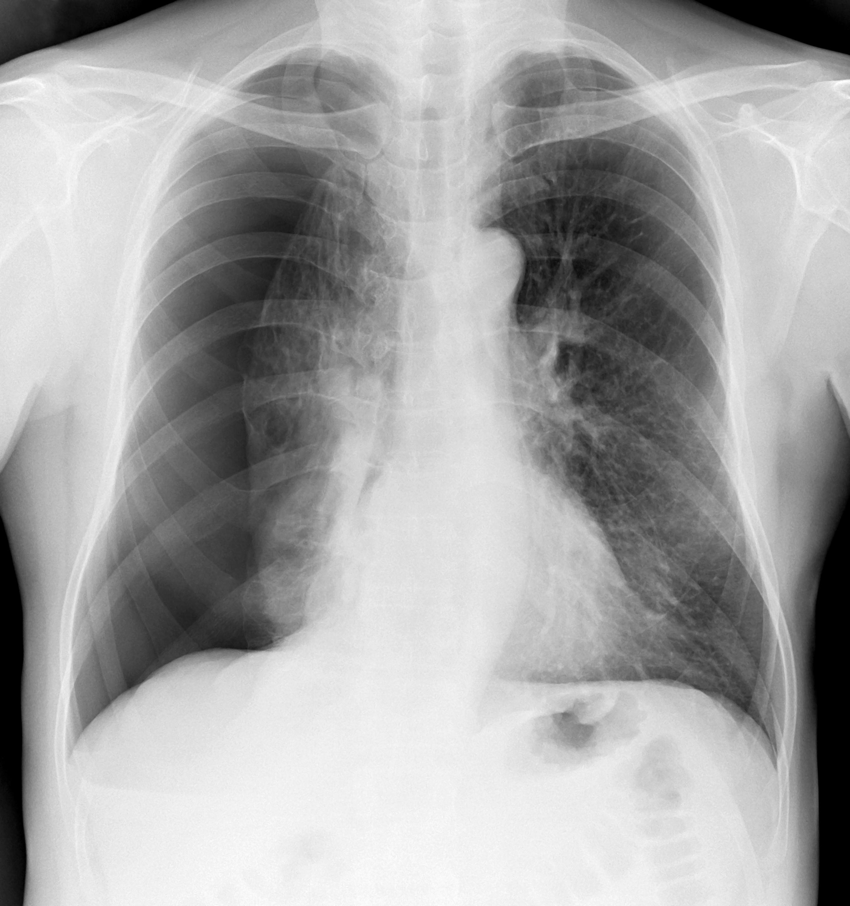
Objectives
To improve diagnostic efficiency and accuracy compared to traditional methods by leveraging chest X-ray images.
Deep Learning
CNN
ResNet-50

Slide 5
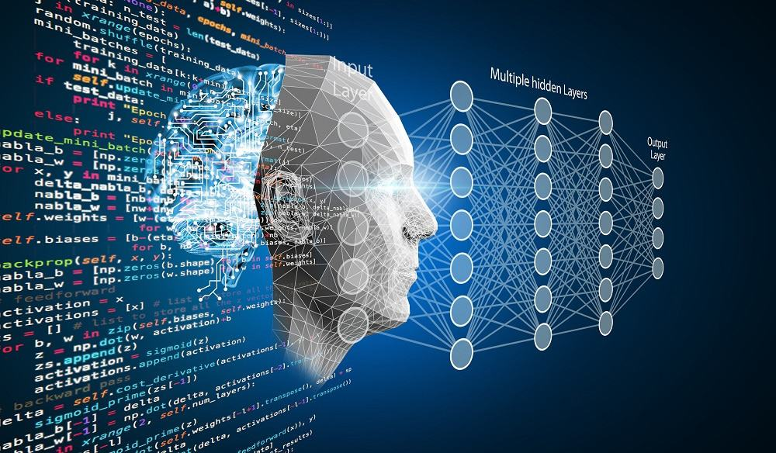
What is Deep Learning ?

Slide 6
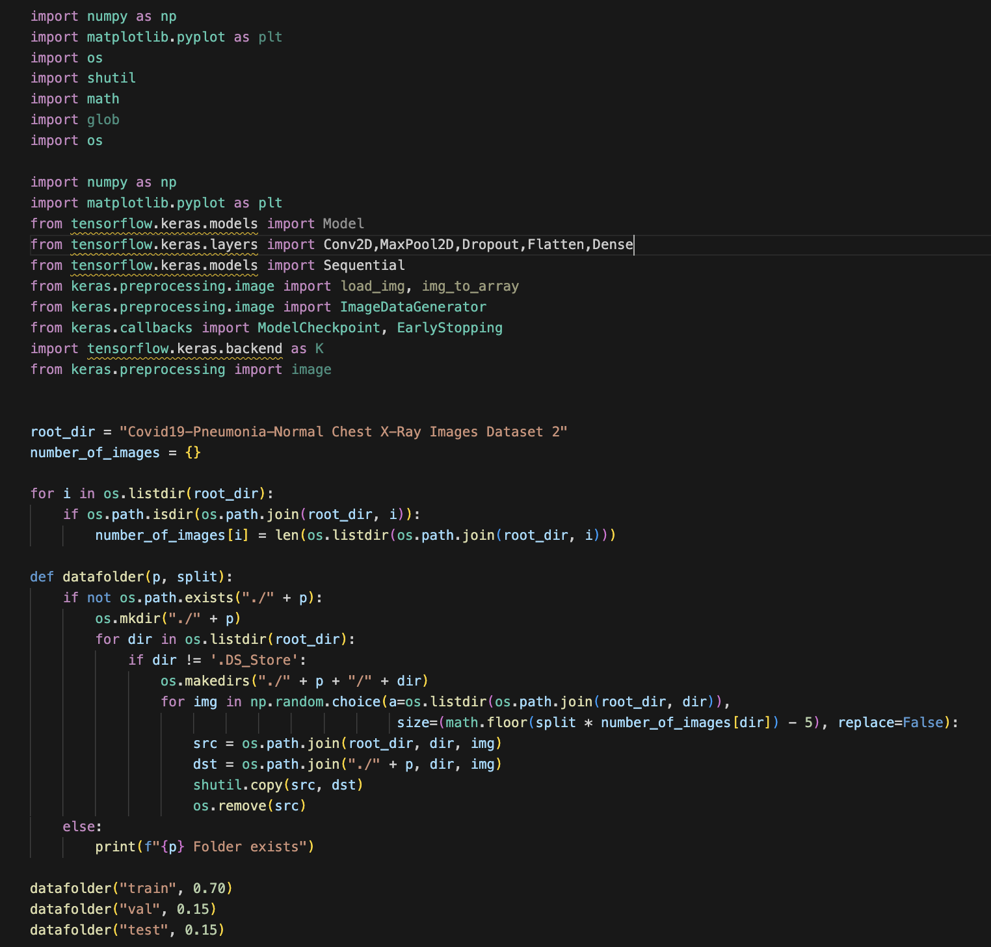
Data Preparation
Organize the data into:
Training
Testing
validation

Slide 7
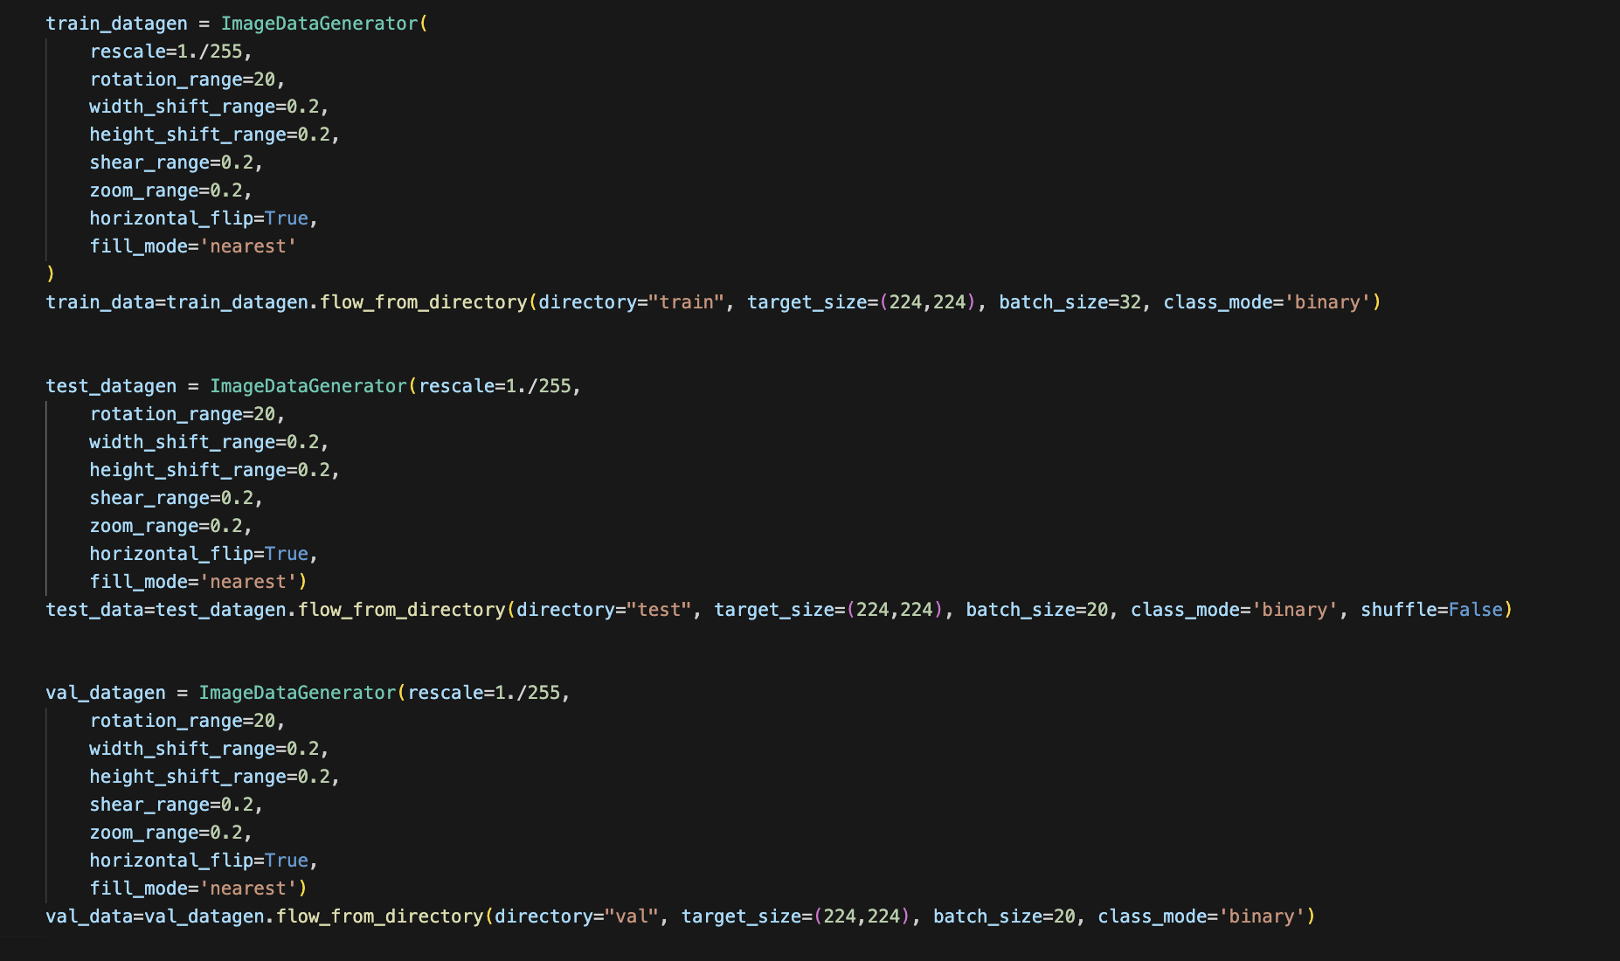
Data Augmentation
Improve the generlization
of models:
Rotation
Shifting
Fliping

Slide 8
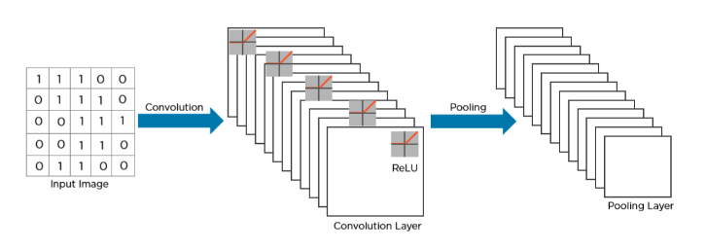
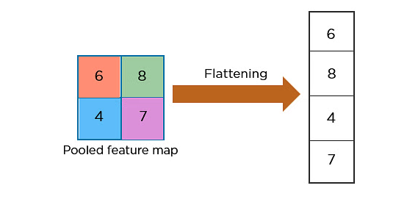
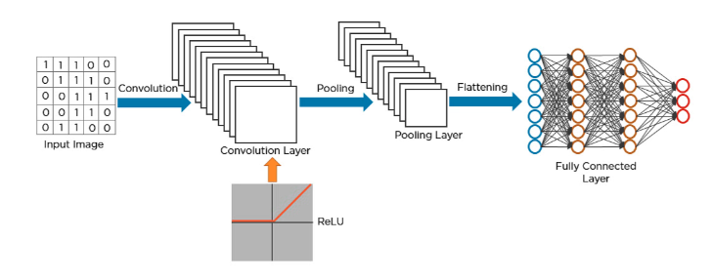
Convolutional Neural Network
1
Building Convolutional Layers.
How exactly CNN recognize the COVID-19
3
2

Slide 9
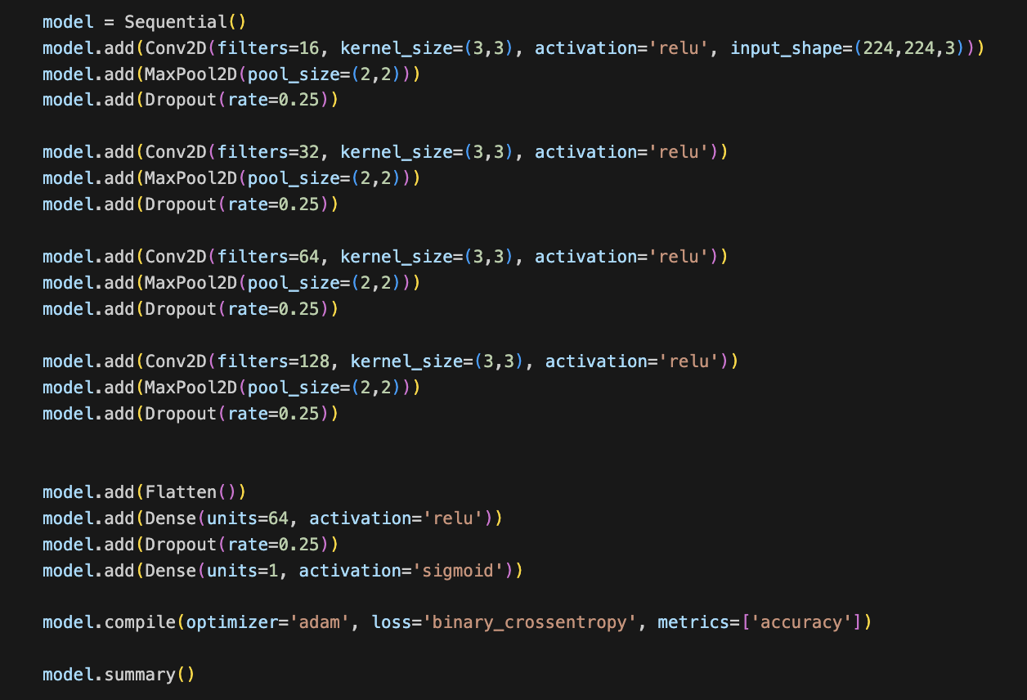
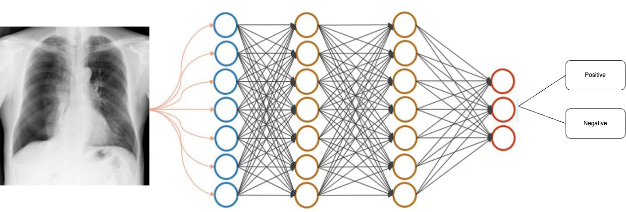
CNN Implementation

Slide 10
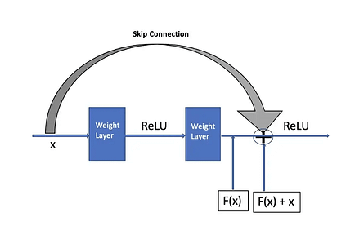
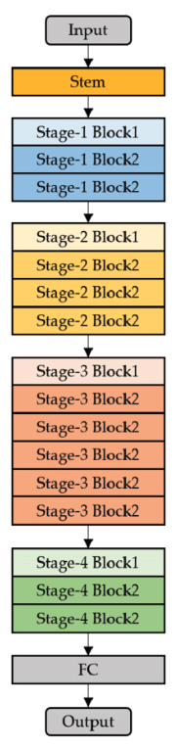
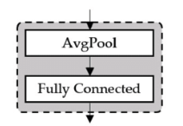
ResNet-50
1
ResNet-50 is part of deep residual learning.
Address the vanishing gradients problem with skip connections.
2
3

Slide 11
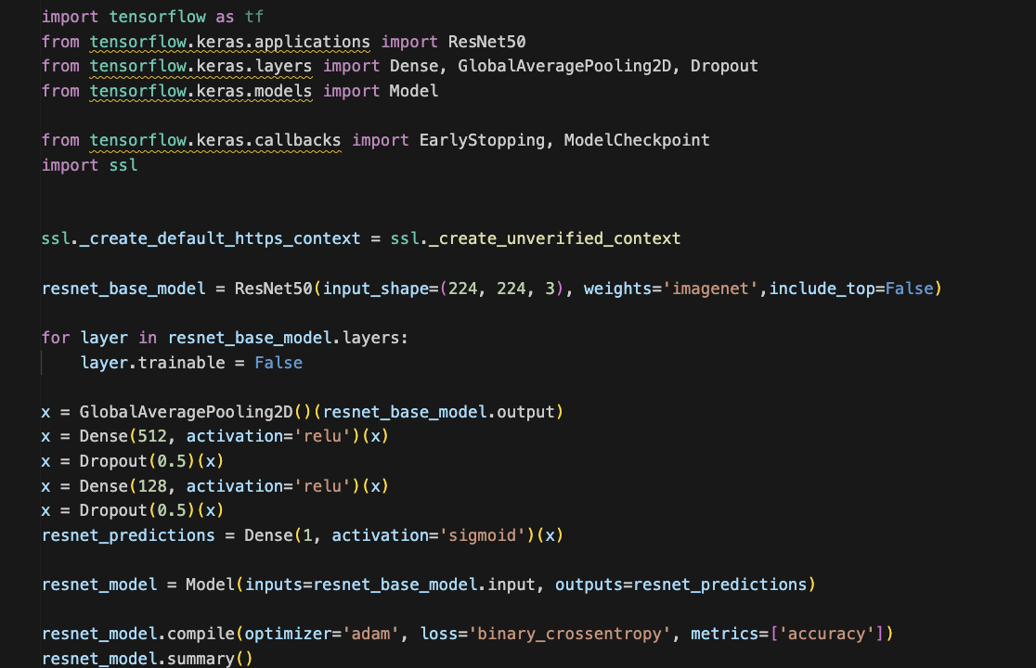
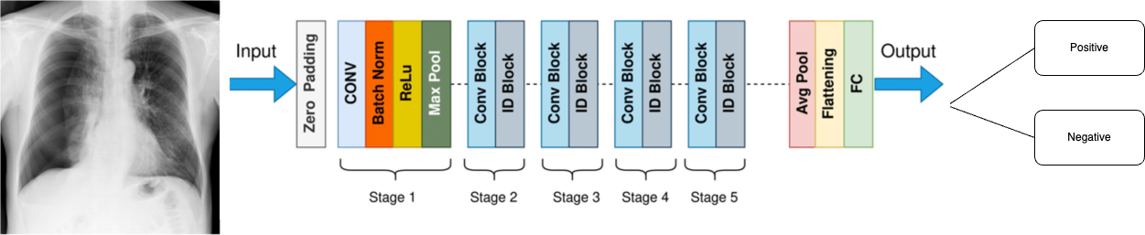
ResNet-50 Implementation

Slide 12
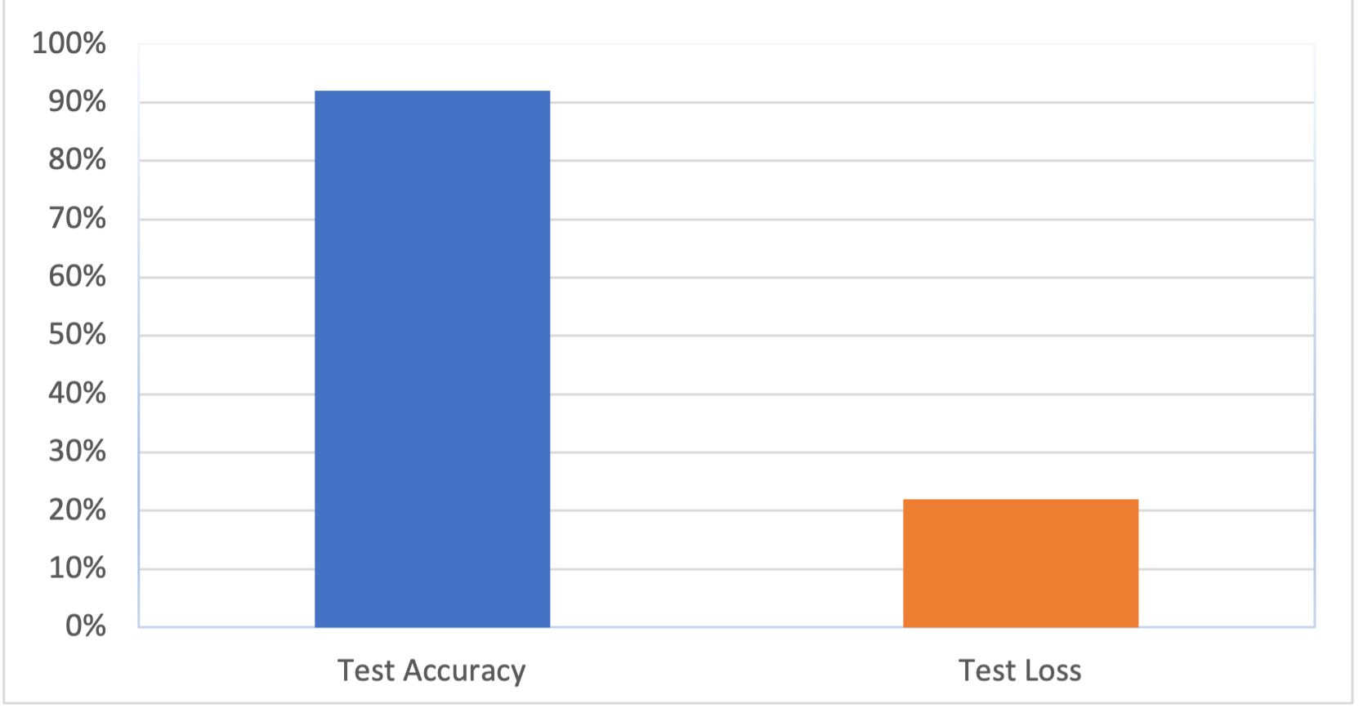
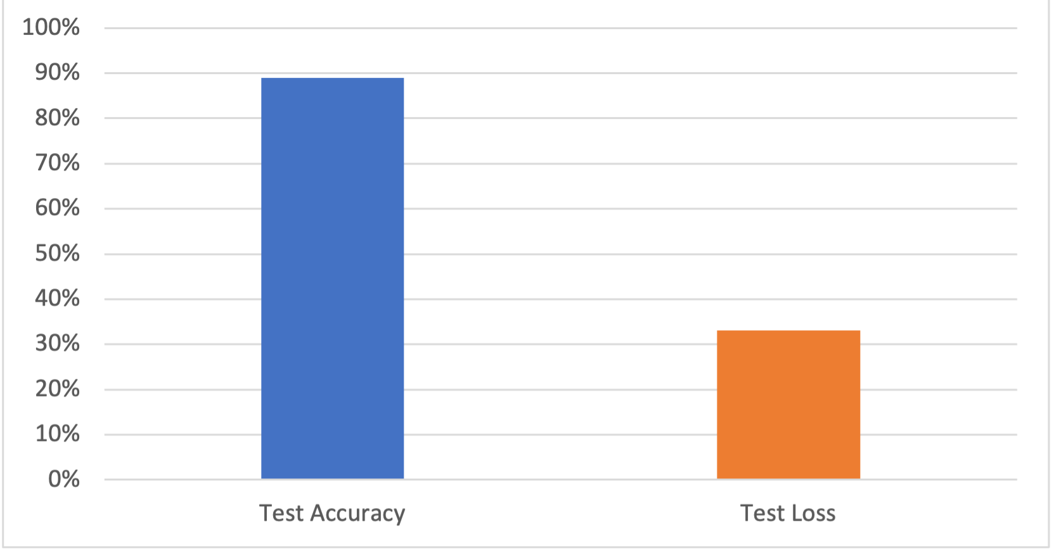

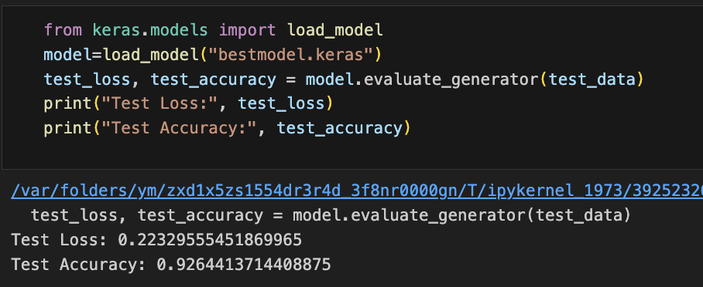
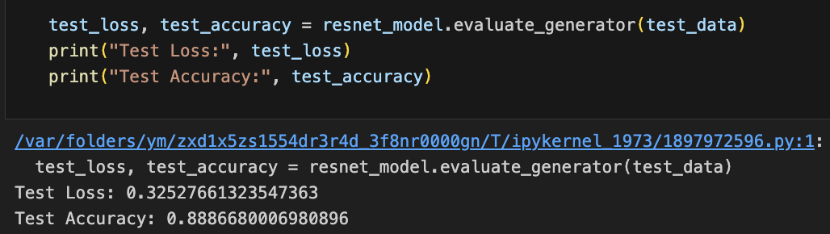
Models Accuracy
CNN
ResNet50

Slide 13
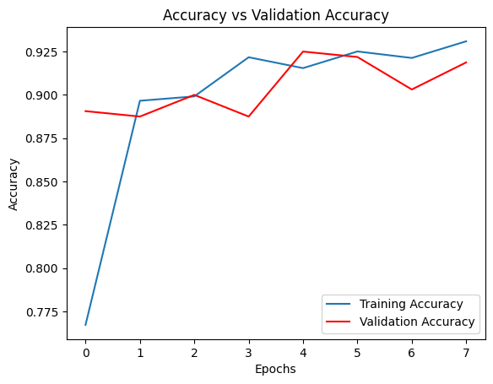
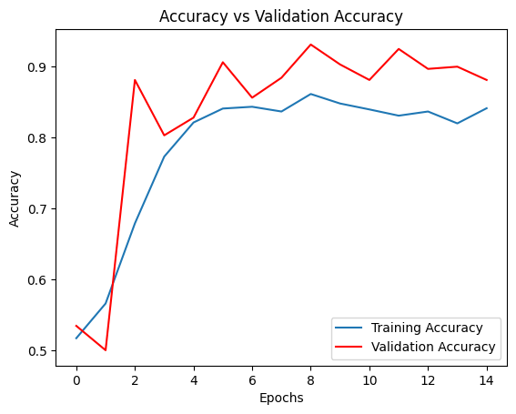
Models Accuracy Graphs
CNN
ResNet50

Slide 14
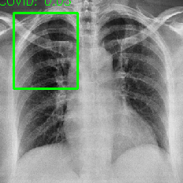
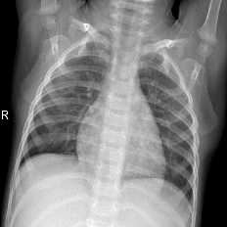
Region Of Interest
ROI detection involves identifying specific areas within chest X-rays images that show signs of infection.
Above threshold of 0.5 indicate COVID-19
Below 0.5 indicate NON COVID-19

Slide 15
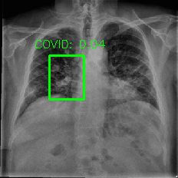
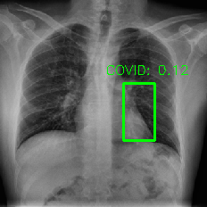

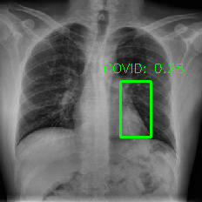
ROI Models Results
CNN
ResNet50

Slide 16
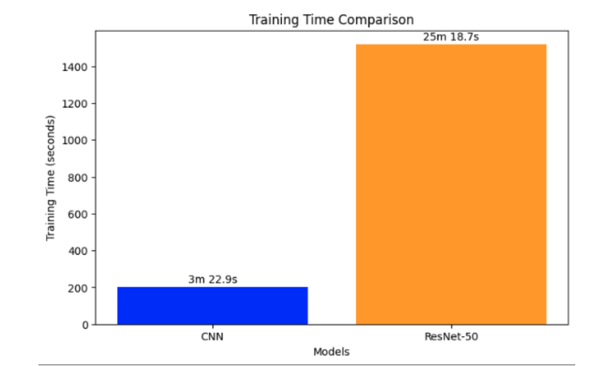
Comparison Of Models Training Time
The CNN model required less time to train.
The ResNet-50 model, due to complexity architecture and depth, took a longer.
ResNet-50 provide less accuracy due to its depth and complexity.

Slide 17
Future Development
Conclusion
CNN model good for small dataset classification.
ResNet-50 highly recommended for the medical image analysis.
To achieve best results through increasing the dataset, recommended for the ResNet-50.
Further studies apply regularization methods.
Classification with recent models.

Slide 18
Thank You!!

